Slide 1
Chapter 2: Processes & Threads

Slide 2
Outline
Process Concept
Process Scheduling
Operations on Processes

Slide 3
Process Concept
An operating system executes a variety of programs that run as a process.
Process – a program in execution; process execution must progress in sequential fashion. No parallel execution of instructions of a single process
Multiple parts
The program code, also called text section
Current activity including program counter, processor registers
Stack containing temporary data
Function parameters, return addresses, local variables
Data section containing global variables
Heap containing memory dynamically allocated during run time

Slide 4
Process Concept (Cont.)
Program is passive entity stored on disk (executable file); process is active
Program becomes process when an executable file is loaded into memory
Execution of program started via GUI mouse clicks, command line entry of its name, etc.
One program can be several processes
Consider multiple users executing the same program

Slide 5
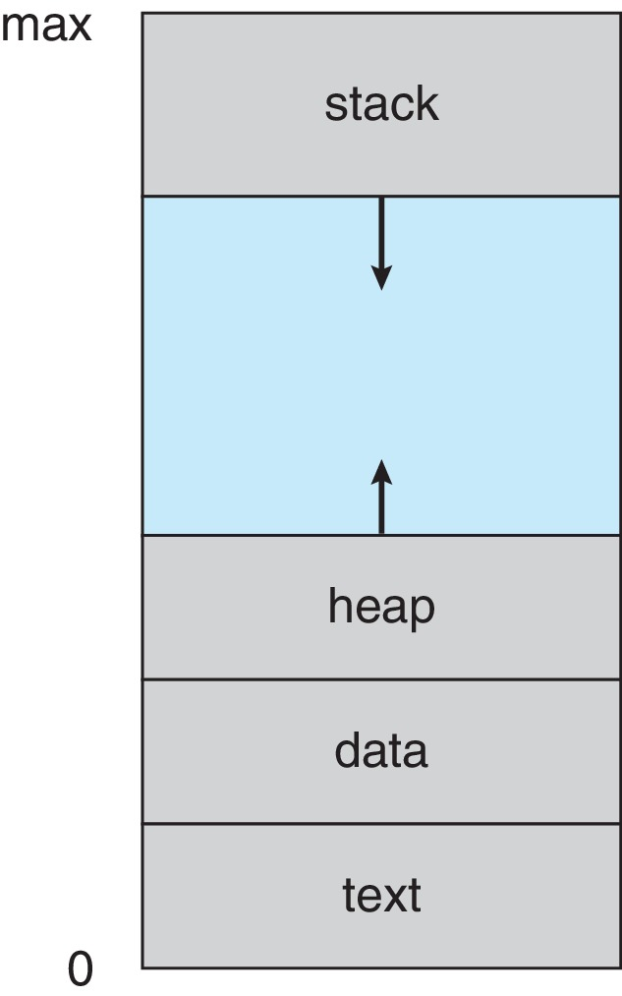
Process in Memory (Self Study)

Slide 6
Process State
As a process executes, it changes state
New: The process is being created
Running: Instructions are being executed
Waiting: The process is waiting for some event to occur
Ready: The process is waiting to be assigned to a processor
Terminated: The process has finished execution

Slide 7
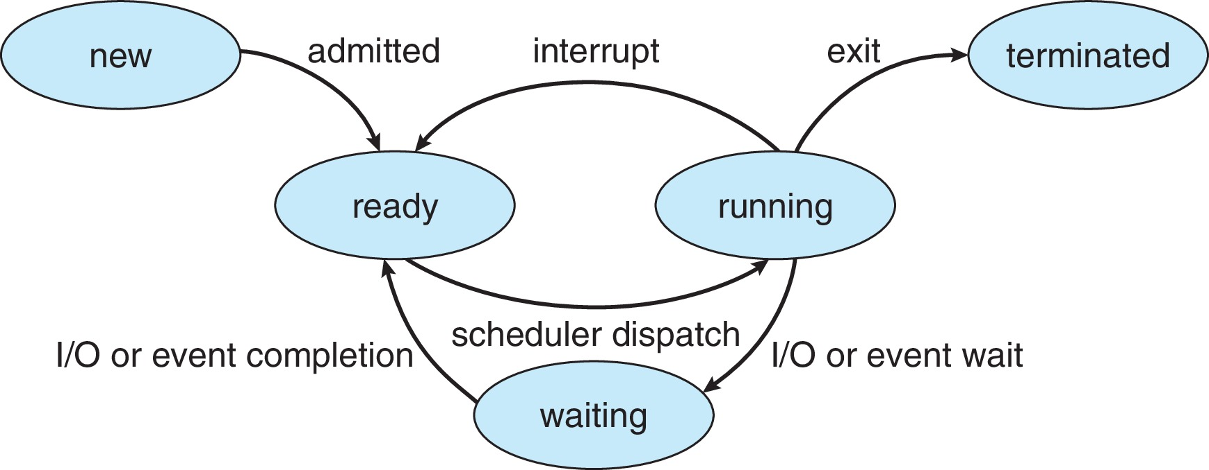
Diagram of Process State

Slide 8
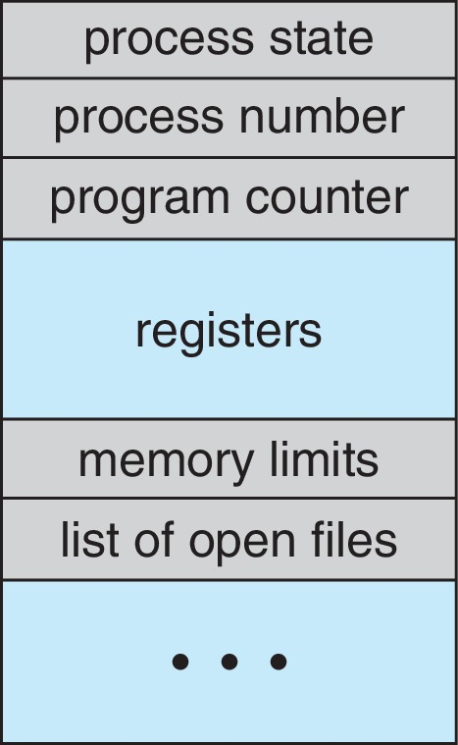
Process Control Block (PCB)
Information associated with each process(also called task control block)
Process state – running, waiting, etc.
Program counter – location of instruction to next execute
CPU registers – contents of all process-centric registers
CPU scheduling information- priorities, scheduling queue pointers
Memory-management information – memory allocated to the process
Accounting information – CPU used, clock time elapsed since start, time limits
I/O status information – I/O devices allocated to process, list of open files

Slide 9
Threads (Self Study)
So far, process has a single thread of execution
Consider having multiple program counters per process
Multiple locations can execute at once
Multiple threads of control -> threads
Must then have storage for thread details, multiple program counters in PCB
Explore in detail in Chapter 4

Slide 10
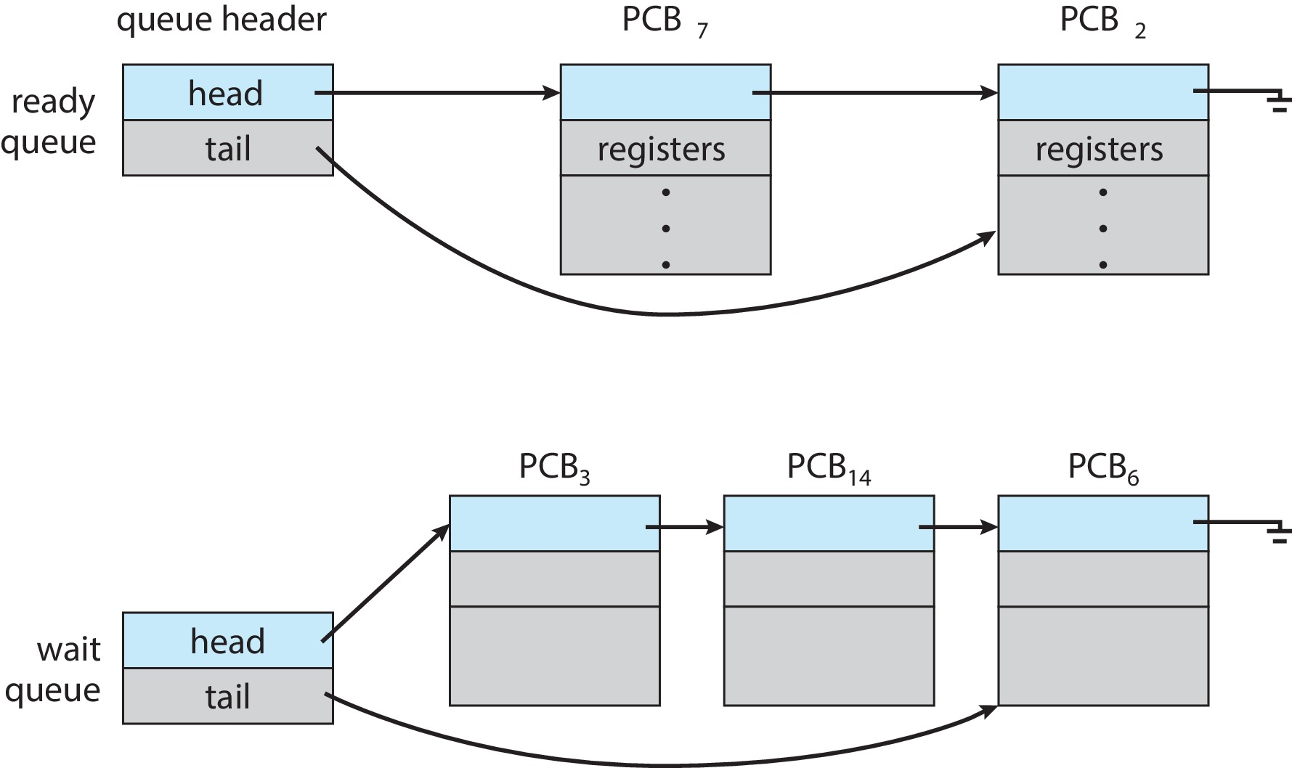
Ready and Wait Queues (Self Study)

Slide 11
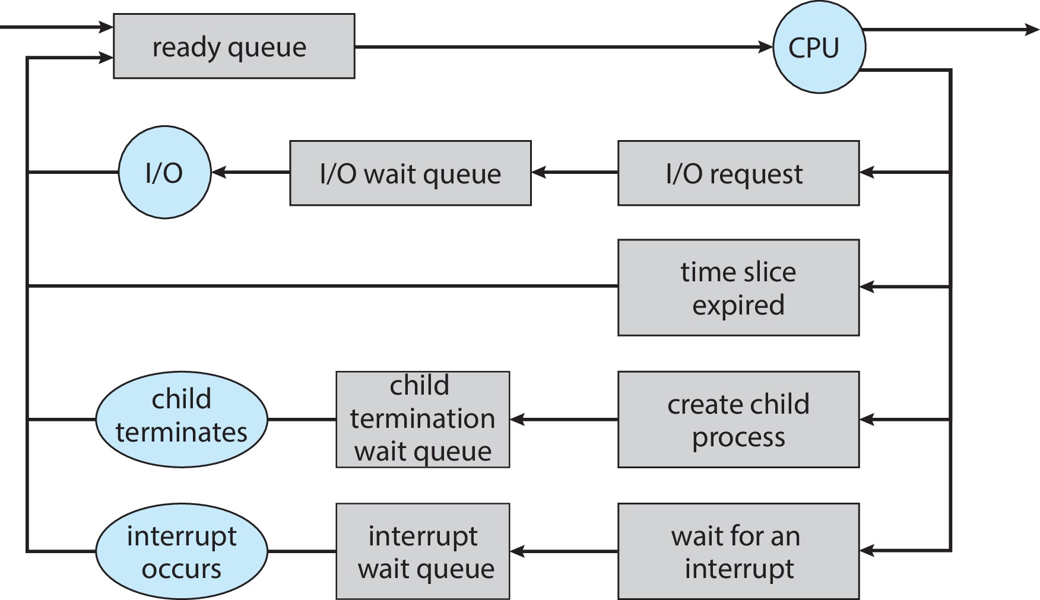
Representation of Process Scheduling (Self Study)

Slide 12
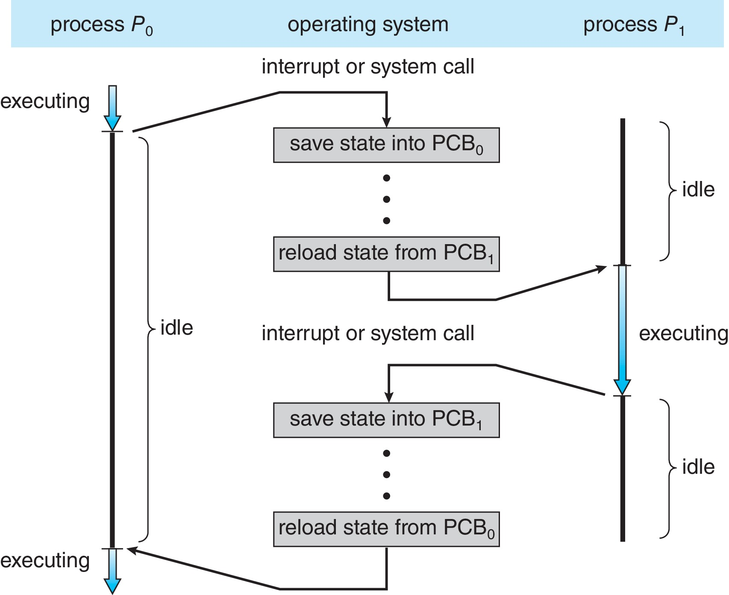
CPU Switch From Process to Process
A context switch occurs when the CPU switches from one process to another.

Slide 13
Context Switch
When CPU switches to another process, the system must save the state of the old process and load the saved state for the new process via a context switch
Context of a process represented in the PCB
Context-switch time is pure overhead; the system does no useful work while switching
The more complex the OS and the PCB ➔ the longer the context switch
Time dependent on hardware support
Some hardware provides multiple sets of registers per CPU ➔ multiple contexts loaded at once

Slide 14
Operations on Processes
System must provide mechanisms for:
Process creation
Process termination

Slide 15
Process Creation
Parent process create children processes, which, in turn create other processes, forming a tree of processes
Generally, process identified and managed via a process identifier (pid)
Resource sharing options
Parent and children share all resources
Children share subset of parent’s resources
Parent and child share no resources
Execution options
Parent and children execute concurrently
Parent waits until children terminate

Slide 16
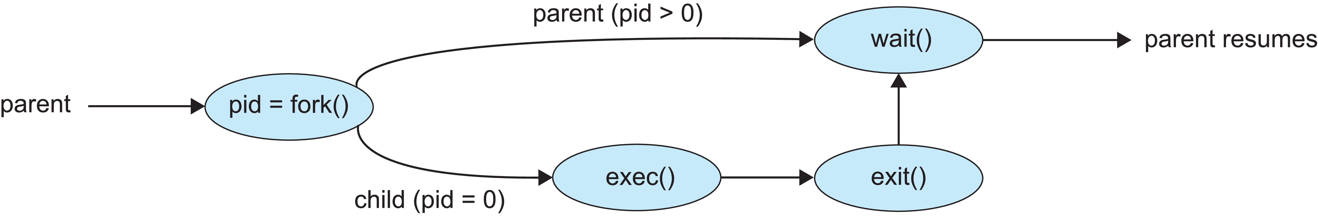
Process Creation (Cont.)
Address space
Child duplicate of parent
Child has a program loaded into it
UNIX examples
fork() system call creates new process
exec() system call used after a fork() to replace the process’ memory space with a new program
Parent process calls wait()waiting for the child to terminate

Slide 17
Process Termination
Process executes last statement and then asks the operating system to delete it using the exit() system call.
Returns status data from child to parent (via wait())
Process’ resources are deallocated by operating system
Parent may terminate the execution of children processes using the abort() system call. Some reasons for doing so:
Child has exceeded allocated resources
Task assigned to child is no longer required
The parent is exiting, and the operating systems does not allow a child to continue if its parent terminates

Slide 18
Process Termination
Some operating systems do not allow child to exists if its parent has terminated. If a process terminates, then all its children must also be terminated.
cascading termination. All children, grandchildren, etc., are terminated.
The termination is initiated by the operating system.
The parent process may wait for termination of a child process by using the wait()system call. The call returns status information and the pid of the terminated process
pid = wait(&status);
If no parent waiting (did not invoke wait()) process is a zombie
If parent terminated without invoking wait(), process is an orphan

Slide 19
Chapter 2 (Cont’d): Threads

Slide 20
Outline
Overview
Multicore Programming
Multithreading Models
Thread Libraries
Threading Issues

Slide 21
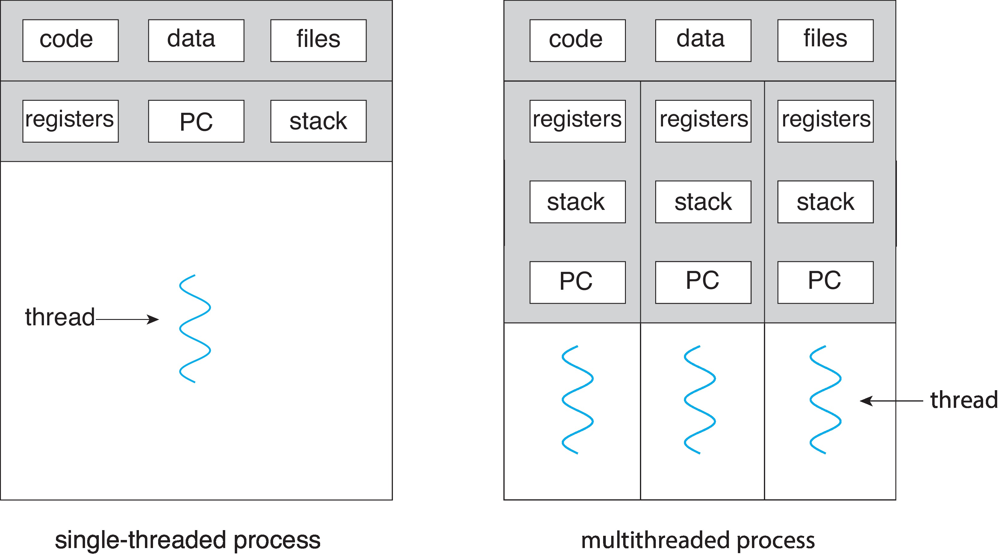
Single and Multithreaded Processes

Slide 22
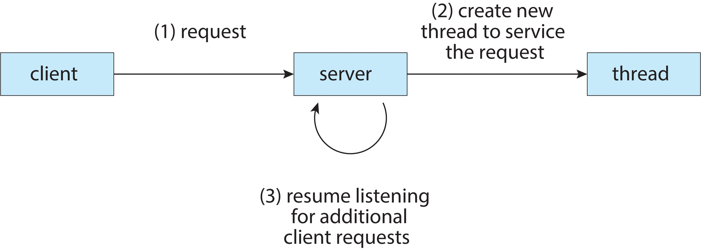
Multithreaded Server Architecture

Slide 23
Benefits
Responsiveness – may allow continued execution if part of process is blocked, especially important for user interfaces
Resource Sharing – threads share resources of process, easier than shared memory or message passing
Economy – cheaper than process creation, thread switching lower overhead than context switching
Scalability – process can take advantage of multicore architectures

Slide 24
Multicore Programming
Multicore or multiprocessor systems puts pressure on programmers, challenges include:
Dividing activities
Balance
Data splitting
Data dependency
Testing and debugging
Parallelism implies a system can perform more than one task simultaneously
Concurrency supports more than one task making progress
Single processor / core, scheduler providing concurrency

Slide 25
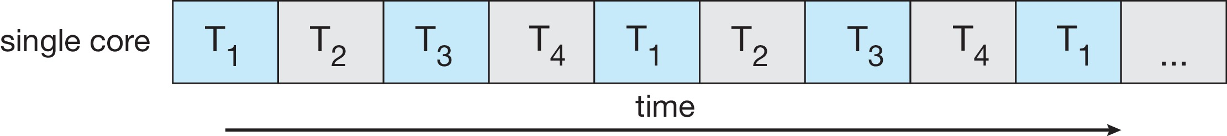
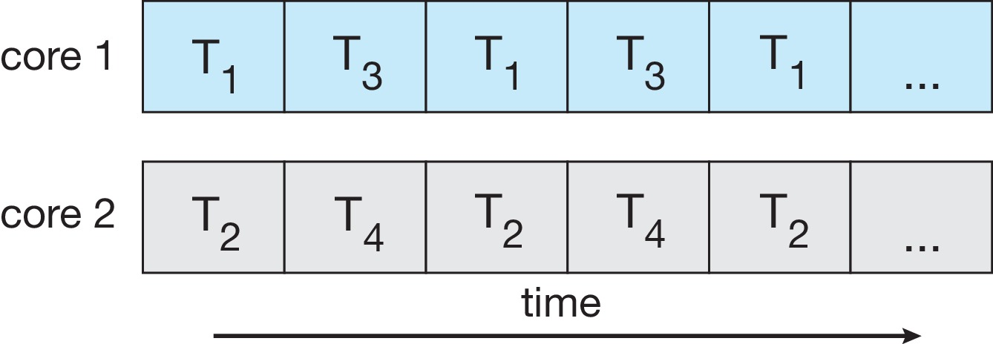
Concurrency vs. Parallelism
Concurrent execution on single-core system:
Parallelism on a multi-core system:

Slide 26
Multicore Programming (Self Study)
Types of parallelism
Data parallelism – distributes subsets of the same data across multiple cores, same operation on each
Task parallelism – distributing threads across cores, each thread performing unique operation

Slide 27
User Threads and Kernel Threads
User threads - management done by user-level threads library
Three primary thread libraries:
POSIX Pthreads
Windows threads
Java threads
Kernel threads - Supported by the Kernel
Examples – virtually all general-purpose operating systems, including:
Windows
Linux
Mac OS X
iOS
Android

Slide 28
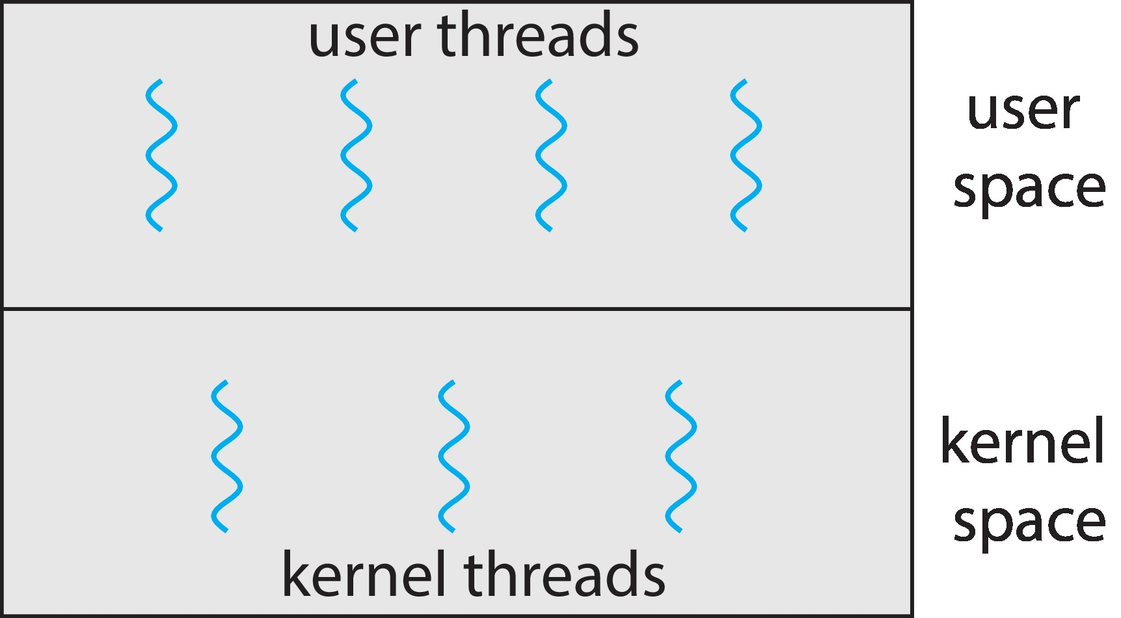
User and Kernel Threads

Slide 29
Multithreading Models
Many-to-One
One-to-One
Many-to-Many

Slide 30
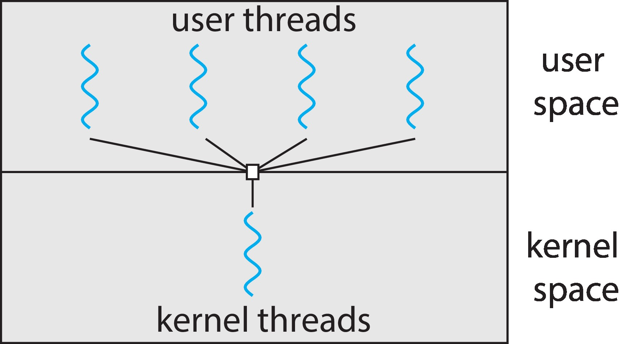
Many-to-One
Many user-level threads mapped to single kernel thread
One thread blocking causes all to block
Multiple threads may not run in parallel on multicore system because only one may be in kernel at a time
Few systems currently use this model
Examples:
Solaris Green Threads
GNU Portable Threads

Slide 31
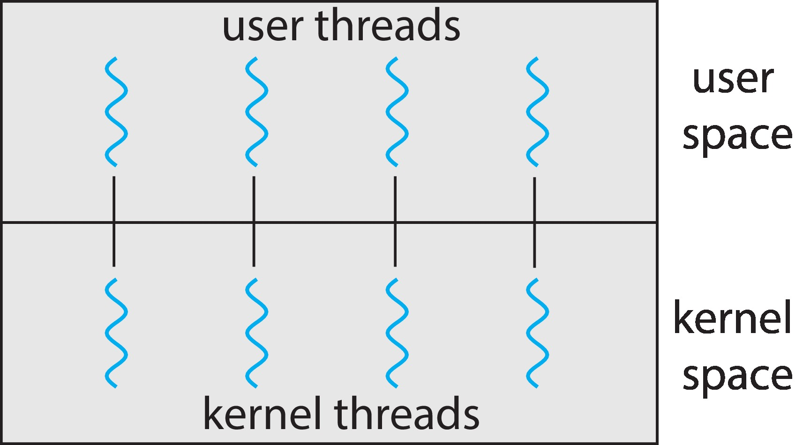
One-to-One
Each user-level thread maps to kernel thread
Creating a user-level thread creates a kernel thread
More concurrency than many-to-one
Number of threads per process sometimes restricted due to overhead
Examples
Windows
Linux

Slide 32
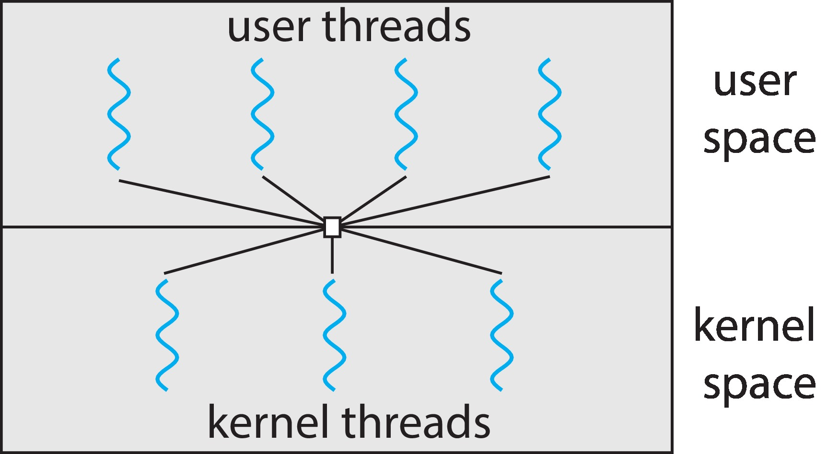
Many-to-Many Model
Allows many user level threads to be mapped to many kernel threads
Allows the operating system to create a sufficient number of kernel threads
Windows with the ThreadFiber package
Otherwise not very common

Slide 33
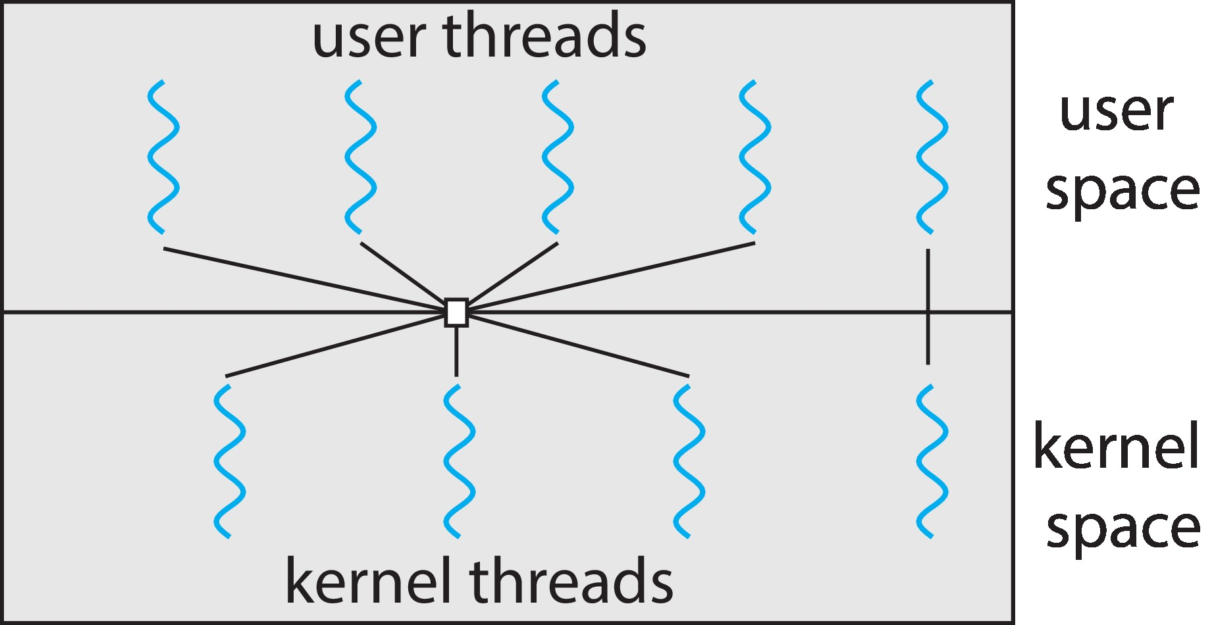
Two-level Model
Similar to M:M, except that it allows a user thread to be bound to kernel thread

Slide 34
Thread Libraries
Thread library provides programmer with API for creating and managing threads
Two primary ways of implementing
Library entirely in user space
Kernel-level library supported by the OS

Slide 35
Pthreads (Self Study)
May be provided either as user-level or kernel-level
A POSIX standard (IEEE 1003.1c) API for thread creation and synchronization
Specification, not implementation
API specifies behavior of the thread library, implementation is up to development of the library
Common in UNIX operating systems (Linux & Mac OS X)

Slide 36
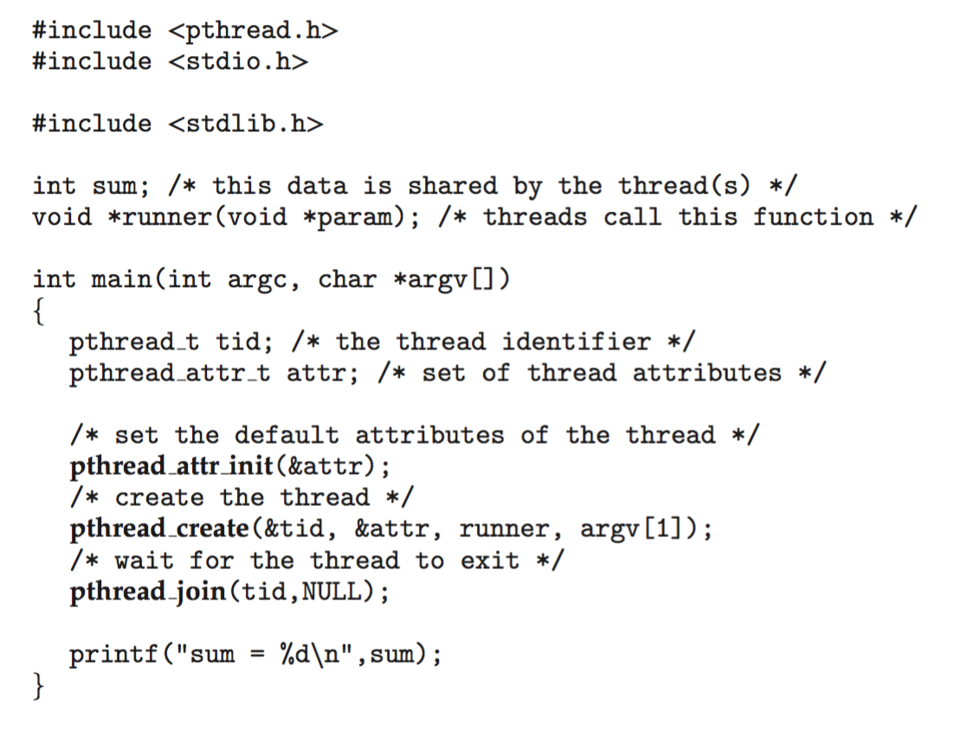
Pthreads Example (Self Study)

Slide 37
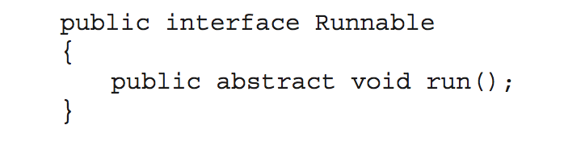
Java Threads (Self Study)
Java threads are managed by the JVM
Typically implemented using the threads model provided by underlying OS
Java threads may be created by:
Extending Thread class
Implementing the Runnable interface
Standard practice is to implement Runnable interface

Slide 38
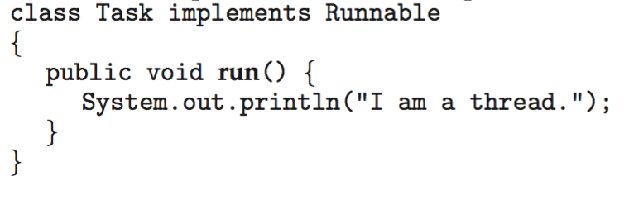
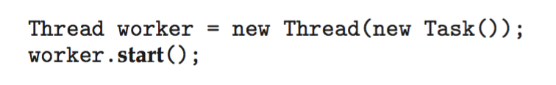
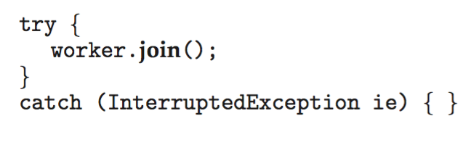
Java Threads (Self Study)
Implementing Runnable interface:
Creating a thread:
Waiting on a thread:

Slide 39
Threading Issues (Self Study)
Semantics of fork() and exec() system calls
Signal handling
Synchronous and asynchronous
Thread cancellation of target thread
Asynchronous or deferred
Thread-local storage
Scheduler Activations

Slide 40
Semantics of fork() and exec() (Self Study)
Does fork()duplicate only the calling thread or all threads?
Some UNIXes have two versions of fork
exec() usually works as normal – replace the running process including all threads

Slide 41
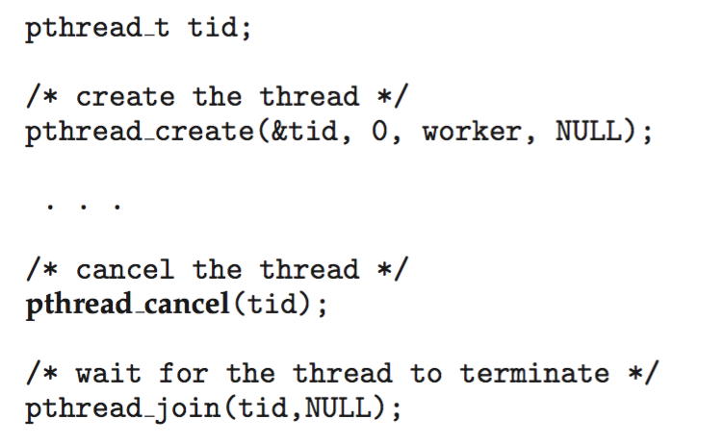
Thread Cancellation
Terminating a thread before it has finished
Thread to be canceled is target thread
Two general approaches:
Asynchronous cancellation terminates the target thread immediately
Deferred cancellation allows the target thread to periodically check if it should be cancelled
Pthread code to create and cancel a thread:

Slide 42
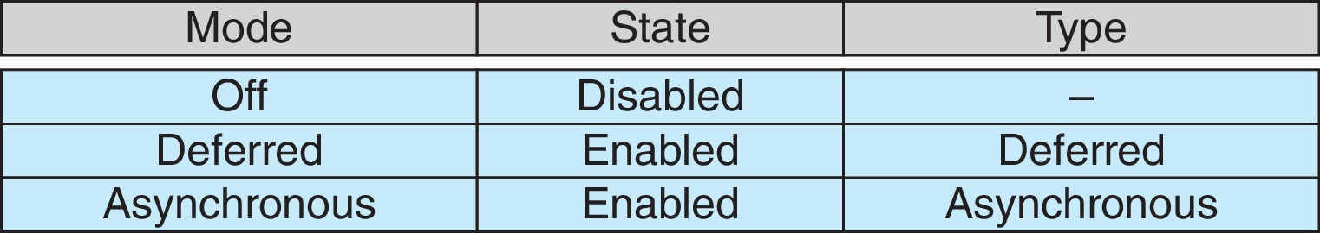
Thread Cancellation (Cont.)
Invoking thread cancellation requests cancellation, but actual cancellation depends on thread state
If thread has cancellation disabled, cancellation remains pending until thread enables it
Default type is deferred
Cancellation only occurs when thread reaches cancellation point
i.e., pthread_testcancel()
Then cleanup handler is invoked
On Linux systems, thread cancellation is handled through signals

Slide 43
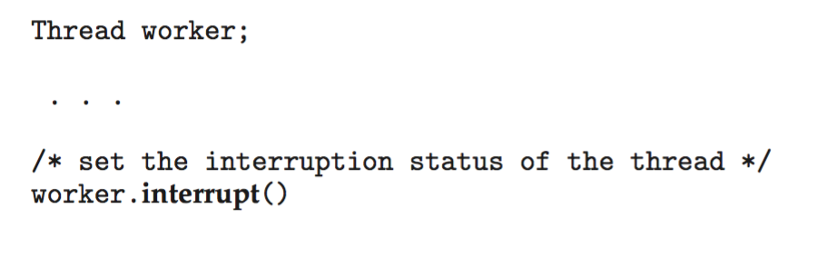
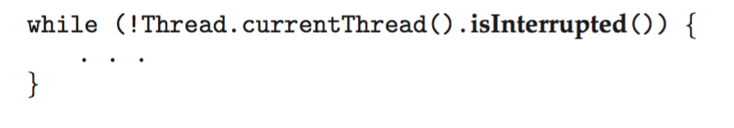
Thread Cancellation in Java (Self Study)
Deferred cancellation uses the interrupt() method, which sets the interrupted status of a thread.
A thread can then check to see if it has been interrupted:

Slide 44
End of Chapter 2

